Slide 1

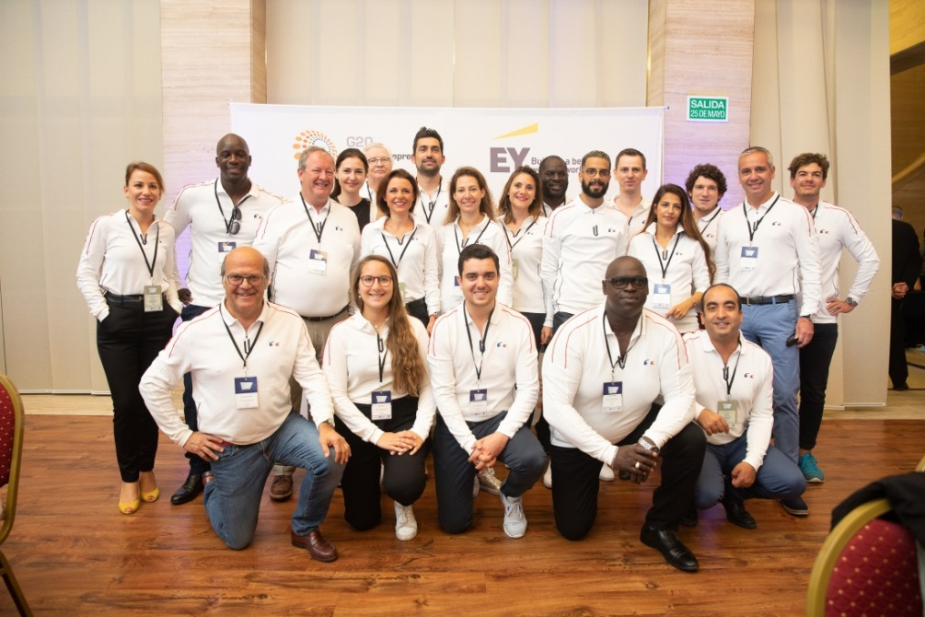





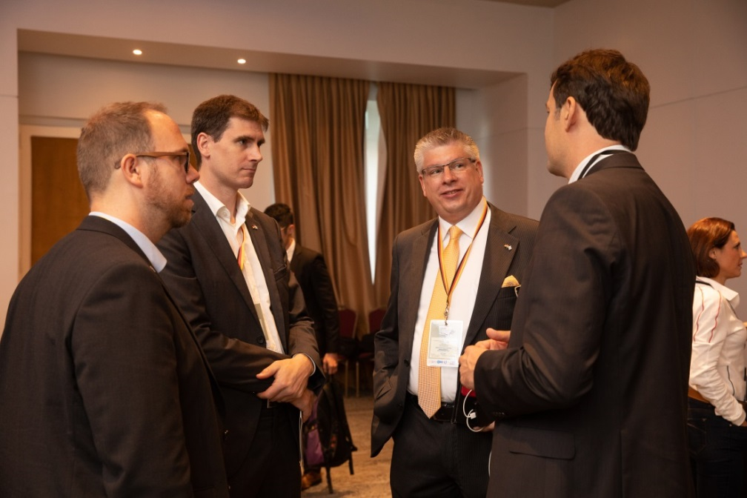


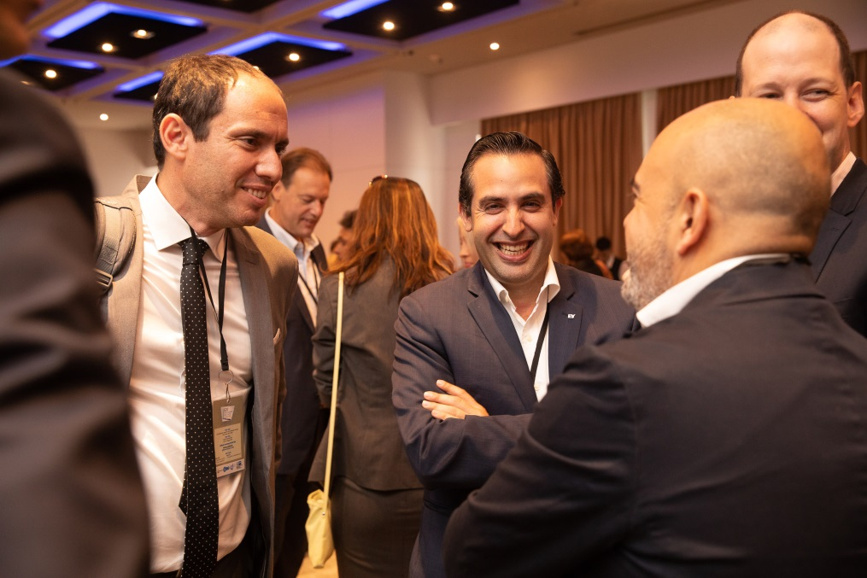


Slide 3



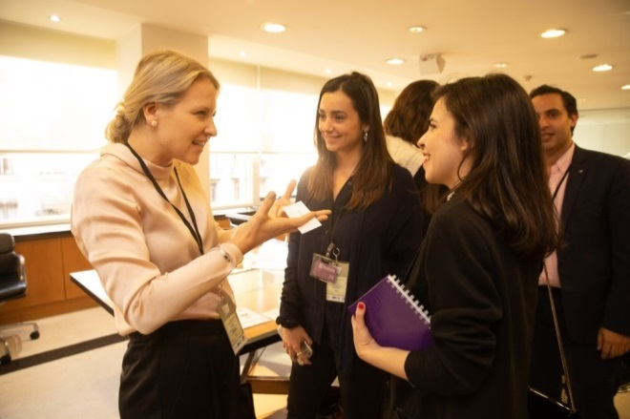

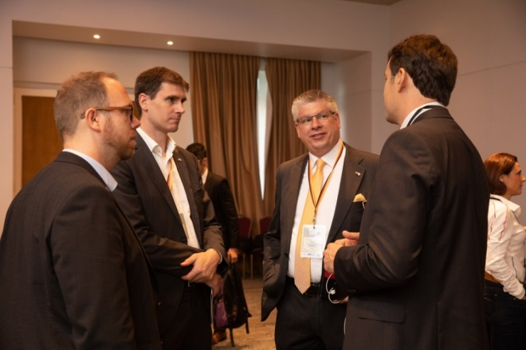




Slide 4




STARTUP
PROGRAMS
ACCELERATION
PROGRAMS
MENTORING
PROGRAMS
SCALEUP
PROGRAMS
EDUCATIONAL
PROGRAMS
ECOSYSTEM
PROGRAMS

Slide 7

STARTUP
PROGRAMS
ACCELERATION
PROGRAMS
MENTORING
PROGRAMS
SCALEUP
PROGRAMS
EDUCATIONAL
PROGRAMS
ECOSYSTEM
PROGRAMS

Slide 9

ACCELERATION
PROGRAMS
SCALEUP
PROGRAMS
MENTORING
PROGRAMS

Slide 10
ACCELERATION
PROGRAMS
SCALEUP
PROGRAMS
MENTORING
PROGRAMS

Slide 11
STARTUP
PROGRAMS
ACCELERATION
PROGRAMS
MENTORING
PROGRAMS
SCALEUP
PROGRAMS
EDUCATIONAL
PROGRAMS
ECOSYSTEM
PROGRAMS

Slide 12
STARTUP
PROGRAMS
ACCELERATION
PROGRAMS
MENTORING
PROGRAMS
SCALEUP
PROGRAMS
EDUCATIONAL
PROGRAMS
ECOSYSTEM
PROGRAMS

Slide 13



